Slide 1

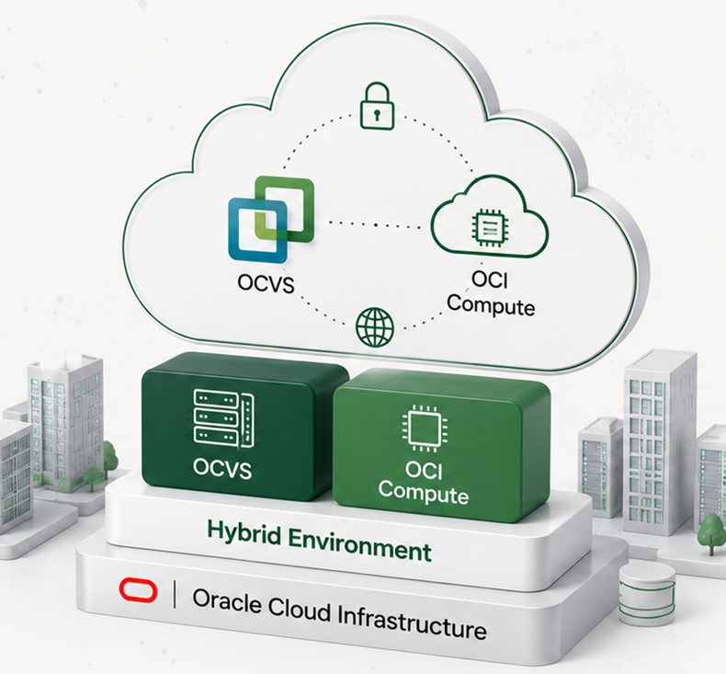




Hybrid Scenario
OCVS + OCI Compute
Proposed Sizing
Customer
CLIENT
Date
May 2025
Prepared By
Oracle Cloud VMware Specialist
Notes:
[Sources]
Source image: user-provided screenshot "Hybrid Scenario". Logo, customer/date/prepared-by icons, Oracle mark, and the right-side hybrid infrastructure illustration are embedded as cropped image assets from that screenshot; visible title, subtitle, sizing label, customer/date/prepared-by labels and values are editable PowerPoint text.

Slide 2




























Hybrid Migration with Oracle Cloud
Combine Oracle Cloud VMware Solution (OCVS) and OCI Compute to modernize workloads at your own pace.
BUSINESS OUTCOMES
Flexibility to run and
modernize at your pace
Optimize costs and
improve efficiency
Leverage best-in-class
security and reliability
Accelerate innovation
with cloud-native services
Lower Costs
Optimize infrastructure and
reduce operational costs.
YOUR CURRENT ENVIRONMENT
MIGRATION & WORKLOAD MOBILITY
TARGET ENVIRONMENT (HYBRID)
Modernize & Innovate
VM
VM
VM
...
VM
Use OCI native services to
accelerate innovation.
On-Premises VMware Environment
VMware Workloads
to OCVS
Workloads to
OCI Compute
Flexible & Scalable
HCX Mobility
OCI Migrations (OCM)
or Third-Party Tools
Scale on demand across
OCVS and OCI.
Production workloads
OCVS
OCI Compute
Secure, seamless migration
of VMware workloads
to Oracle Cloud VMware
Solution.
Migrate and modernize
workloads to OCI Compute
using OCM or partner tools.
Run VMware
Modernize
Secure & Reliable
Business critical applications
Enterprise-grade security
and high availability.
Users & business operations
CONNECTIVITY OPTIONS
Unified Management & Security
Consistent security, governance and
management across all environments.
Future Ready
At risk from cost, complexity
and technical debt
Build a modern, agile
foundation for the future.
Internet
VPN
FastConnect
Modernize at your own pace by combining Oracle Cloud VMware Solution
and OCI Compute in a unified cloud architecture.
Copyright © 2026, Oracle and/or its affiliates
Confidential: Internal/Restricted/Highly Restricted

Slide 3









Assumptions & Methodology
The proposed sizing is based on the information provided by the customer
and the following assumptions and methodology.
Sizing Methodology
Data Source
RVTools export provided by the customer
(Analysis Date: May 08, 2025)
Sizing Approach
Capacity based on current utilization
and projected growth
CPU Contention Ratio
1:6
(Industry standard for medium consolidation)
Average Utilization
vCPU: 50%
vMEM: 60%
Target Utilization
80%
(For both vCPU and vMEM)
Storage Type
OCI Block Volume
(Block Storage)
Copyright © 2026, Oracle and/or its affiliates | Confidential: Internal/Restricted/Highly Restricted

Slide 4













Current Environment
Analysis based on RVTools data shared by the customer.
Datacenter 1 – CLIENT
VMs
vCPUs
vRAM (GB)
Storage (TB)
20,100
3,000
30,000
210
18,400
Powered On
1,700
Powered Off
Total VMs
Total vCPUs
Total vRAM (GB)
Total Storage (TB)
20,100
3,000
30,000
210
Total Environment
18,400 Powered On
1,700 Powered Off
This sizing is based on the information available at the time of analysis and should be validated during the detailed design phase.
Copyright © 2026, Oracle and/or its affiliates | Confidential: Internal/Restricted/Highly Restricted
Notes:
[Sources]
Source image: user-provided screenshot "Current Environment". Oracle logo, Oracle mark, datacenter icon, metric icons, total-environment icon, and information icon are embedded as cropped image assets from that screenshot. The visible title, subtitle, panel headers, labels, metric values, notes, footer, cards, separators, and decorative background elements are recreated as editable PowerPoint objects.

Slide 5










Infrastructure Sizing Summary
1
ORACLE CLOUD VMWARE SOLUTION (OCVS)
2
OCI COMPUTE
SDDCs
1
Compute Mix (by Shape)
Storage Mix (by VPU)
Clusters
1
Production
Compute Shape
VMs
OCPU
RAM
(GB)
VPU Range (per VM)
Performance Tier
(IOPS)
Total VMs
Total VPU
Capacity
Hosts
4
VM.Standard.E5.Flex
32
128
512 GB
0 - 20 VPU
Balanced
(10K IOPS)
30
180
5.4 TB
4
x AMD E4
+
GB
Shape
AMD E4
VM.Standard.E6.Flex
24
96
384 GB
21 - 80 VPU
Balanced
(20K IOPS)
30
1,200
12.0 TB
GB
Storage
200 TB
200
TB
BM.DenseIO.E5
14
56
224 GB
81 - 1200 VPU
High Performance
(60K IOPS)
10
600
6.0 TB
GB
Storage Type
OCI Block Volume
TOTAL
70
280
1.12 TB
TOTAL
70
1,980
23.4 TB
GB
Run VMware workloads on
OCVS
while modernizing at your own pace with
OCI Compute.
A flexible hybrid approach to optimize costs, performance, and innovation.
Copyright © 2026, Oracle and/or its affiliates
Notes:
[Sources]
Source image: user-provided screenshot "Infrastructure Sizing Summary". Oracle logo, Oracle mark, OCVS icons, production icons, OCI compute/storage icons, and the hybrid callout pictogram are embedded as cropped image assets from that screenshot. The slide title, section labels, cards, tables, metrics, totals, separators, callout text, and footer are recreated as editable PowerPoint objects.

